Slide 1


IBM Data Science Capstone Project
Based on Space X
Bharathvarsh Srinivasan

Slide 2

Outline
Executive Summary
Introduction
Methodology
Results
Conclusion
Appendix

Slide 3

Executive Summary
Summary of Methodology
Collection and Data wrangling methodology
EDA and interactive visual analytics methodology
predictive analysis methodology
EDA with visualization
EDA with SQL
interactive map with Folium
Plotly Dash dashboard
predictive analysis (classification)
Summary for Results
EDA Results
Predictive Analysis Results
Interactive Analysis Demo

Slide 4
Introduction
Project Context
Space X manufactures sub-orbital and orbital reusable rockets. SpaceX’s accomplishments include: Sending spacecraft to the International Space Station. Starlink, a satellite internet constellation providing satellite Internet access. Sending manned missions to Space. One reason SpaceX can do this is the rocket launches are relatively inexpensive.
SpaceX advertises Falcon 9 rocket launches on its website with a cost of 62 million dollars; other providers cost upwards of 165 million dollars each, much of the savings is because SpaceX can reuse the first stage. Therefore, if we can determine if the first stage will land, we can determine the cost of a launch.
AIM of the Project
Determine the price of each launch by gathering information about Space X and creating dashboards.
Determine if SpaceX will reuse the first stage.
Instead of using rocket science to determine if the first stage will land successfully, by training a machine learning model and use public information to predict if SpaceX will reuse the first stage.

Slide 5

Methodology
We will be working with SpaceX launch data that is gathered from an API, specifically the SpaceX REST API. This API will give us data about launches, including information about the rocket used, payload delivered, launch specifications, landing specifications, and landing outcome.
Our goal is to use this data to predict whether SpaceX will attempt to land a rocket or not.
The SpaceX REST API endpoints, or URL, starts with api.spacexdata.com/v4/.
We have the different end points, for example: /capsules and /cores
We will be working with the endpoint api.spacexdata.com/v4/launches/past
Another popular data source for obtaining Falcon 9 Launch data is web scraping related Wiki pages using the Python BeautifulSoup package to web scrape some HTML tables that contain valuable Falcon 9 launch records.

Slide 6
Data Collection-Space X API
Objectives
Make a get request to the SpaceX API and do some basic data wrangling and formatting.
Request to the SpaceX API
Clean the requested data

Slide 7
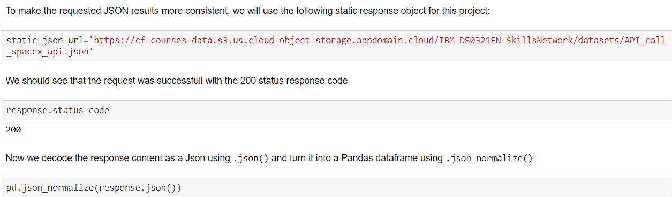
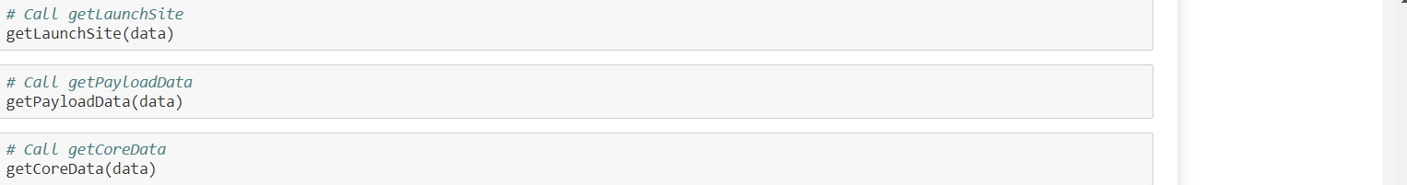
1.Getting response from API
2.Converting response to a .json file and normalizing it
3.Applying functions to the normalized data.

Slide 8
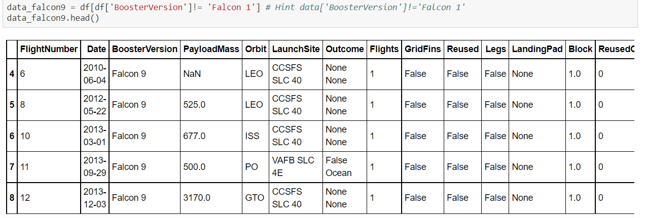
4.Filteration of Data
5.Conversion of Data Frame to a CSV
data_falcon9.to_csv('dataset_part_1.csv', index=False)

Slide 9
Data Collection-Web Scraping
Objectives
Webscraping Falcon 9 launch records with BeautifulSoup:
Extract Falcon 9 launch records HTML table from Wikipedia
Parse the table and convert it into a Pandas dataframe

Slide 10
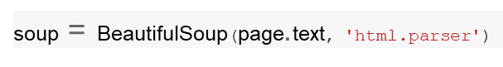
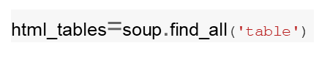
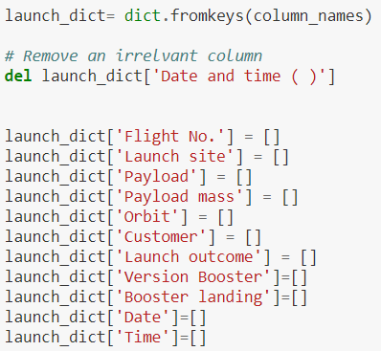
1.Perform an HTTP GET method to request the Falcon9 Launch HTML page, as an HTTP response.
2.Create a BeautifulSoup from the HTML response
3. Collect all relevant column names from the HTML table header
4.Create an empty dictionary with keys from the extracted column names in the previous task.

Slide 11
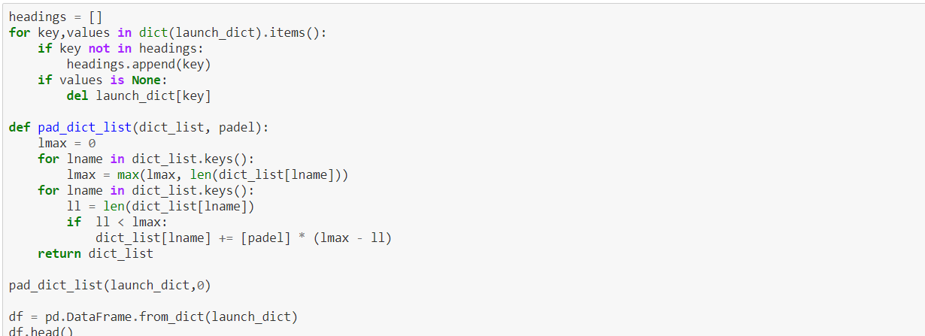
5.Create a dataframe of launch_dict
6.Convert dataframe to CSV

Slide 12
Data Wrangling
Data wrangling is the process of cleaning and unifying messy and complex data sets for easy access and analysis.
With the amount of data and data sources rapidly growing and expanding, it is getting increasingly essential for large amounts of available data to be organized for analysis. This process typically includes manually converting and mapping data from one raw form into another format to allow for more convenient consumption and organization of the data.
Objectives of Data Wrangling
The Goals of Data Wrangling
Reveal a "deeper intelligence" by gathering data from multiple sources
Provide accurate, actionable data in the hands of business analysts in a timely matter
Reduce the time spent collecting and organizing unruly data before it can be utilized
Enable data scientists and analysts to focus on the analysis of data, rather than the wrangling
Drive better decision-making skills by senior leaders in an organization
Data Acquisition
Joining Data
Data Cleansing

Slide 13

Launching pads
Let’s review some of the attributes: Flight Number, Date, Booster version, Payload mass Orbit, Launch Site, Outcome: this is the status of the first stage Flights, Grid Fins: these help with landing Reused, Legs: used in landing pad, Block, Reused count, Serial, Longitude and latitude of launch Let’s take a look at some of these attributes. The column “LaunchSite” contains the different launch sites, including: Vandenberg AFB Space Launch Kennedy Space Center CCAFS SLC 40 The column orbits are the different orbits of the payload. For Example: LEO: Low Earth orbit (LEO)is an Earth-centered orbit with an altitude of 2,000 km GTO A geosynchronous orbit is a high Earth orbit that allows satellites to match Earth's rotation. It is located at 22,236 miles (35,786 kilometers) above Earth's equator.
The column Outcome indicates if the first stage successfully landed. There are 8 of them, for example. True ASDS means the booster successfully landed to a drone ship as shown the following looped video. False ASDS means the mission outcome was unsuccessfully landed to a drone ship as shown in the video loop. Outcome We would like landing outcomes to be converted to Classes y. y. (either 0 or 1). 0 is a bad outcome, that is, the booster did not land. 1 is a good outcome, that is, the booster did land. The variable Y will represent the classification variable that represents the outcome of each launch.

Slide 14
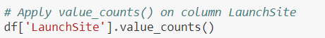
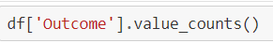
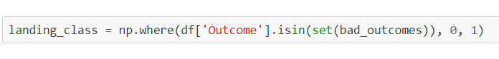
1.Determine No. of Launches using value_counts()
2.Determine the number and occurrence of each orbit in the column Orbit using value_counts()
df['Orbit'].value_counts()
3.Determine the number and occurrence of each Launch Site using value_counts()
df['LaunchSite'].value_counts()
4.Use.value_counts() on the column Outcome to determine the number of landing outcomes.
landing_outcomes=df['Outcome'].value_counts()
5.Using the Outcome, create a list where the element is zero if the corresponding row in Outcome is in the set bad_outcome; otherwise, it's one
6.Calculate the success rate using .mean()
df["Class"].mean()

Slide 15
EDA-Exploratory Data Analysis
Introduction
Exploratory Data Analysis is the first step of any data science project.
We will perform some Exploratory Data Analysis using a database.
We will see if the data can be used to automatically determine if
the Falcon 9’s second stage will land.
Some attributes can be used to determine if the first stage can be reused.
We can then use these features with machine learning to automatically predict if the first
stage can land successfully, for example.

Slide 16
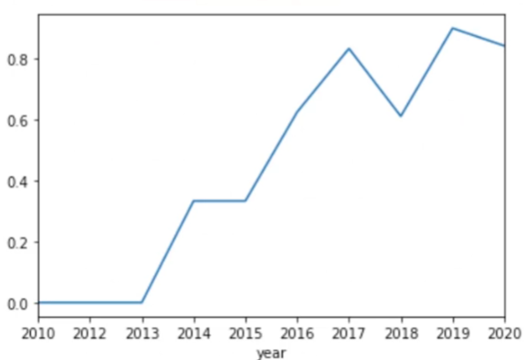
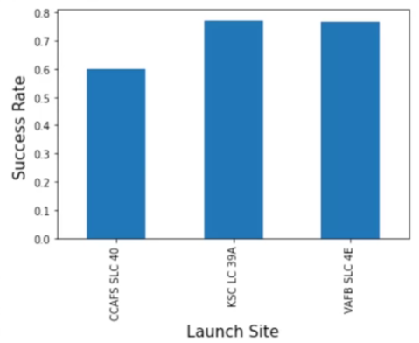
Context
We can observe that the success rate since 2013 has improved. We can incorporate this as a feature via launch Number. We see that different launch sites have different success rates. As a result, they can be used to help determine if the first stage will land successfully. CCAFS LC-40 has a success rate of 60%, while KSC LC-39A and VAFB SLC 4E have a success rate of around 77%. Combining attributes also gives us more information. If we overlay the result of the landing outcomes as a color we see that CCAFS LC-40, has a success rate of 60%, but if the mass is above 10,000 kg the success rate is 100%. Therefore, we will combine multiple features. We will determine what attributes are correlated with successful landings. The categorical variables will be converted using one hot encoding, preparing the data for a machine learning model that will predict if the first stage will successfully land.

Slide 17

EDA with SQL
Objectives
Understand the Spacex DataSet
Load the dataset into the corresponding table in a Db2 database
Execute SQL queries to answer assignment questions
Tasks Given:
Display the names of the unique launch sites in the space mission
Display 5 records where launch sites begin with the string 'CCA'
Display the total payload mass carried by boosters launched by NASA (CRS)
Display average payload mass carried by booster version F9 v1.1
List the date when the first successful landing outcome in ground pad was acheived.
List the names of the boosters which have success in drone ship and have payload mass greater than 4000 but less than 6000
List the total number of successful and failure mission outcomes
List the names of the booster_versions which have carried the maximum payload mass. Use a subquery
List the failed landing_outcomes in drone ship, their booster versions, and launch site names for in year 2015
Rank the count of landing outcomes (such as Failure (drone ship) or Success (ground pad)) between the date 2010-06-04 and 2017-03-20, in descending order.

Slide 18



EDA with Visualization lab
Objectives
Perform exploratory Data Analysis and Feature Engineering using Pandas and Matplotlib
Exploratory Data Analysis
Preparing Data Feature Engineering
Tasks
Visualize the relationship between Flight Number and Launch Site
Visualize the relationship between Payload and Launch Site
Visualize the relationship between success rate of each orbit type
Visualize the relationship between FlightNumber and Orbit type
Visualize the relationship between Payload and Orbit type
Visualize the launch success yearly trend
Create dummy variables to categorical columns
Cast all numeric columns to float64

Slide 19

EDA with Folium
Introduction
Folium is a Python library used for visualizing geospatial data. It is easy to use and yet a powerful library. Folium is a Python wrapper for Leaflet.js which is a leading open-source JavaScript library for plotting interactive maps.
Context
The launch success rate may depend on many factors such as payload mass, orbit type, and so on. It may also depend on the location and proximities of a launch site, i.e., the initial position of rocket trajectories. Finding an optimal location for building a launch site certainly involves many factors and hopefully we could discover some of the factors by analyzing the existing launch site locations. We will be performing nteractive visual analytics using Folium.
Objectives
Mark all launch sites on a map
Mark the success/failed launches for each site on the map
Calculate the distances between a launch site to its proximities
Find some geographical patterns about launch sites.

Slide 20

EDA with Plotly Dash
Introduction
The dashboard application contains input components such as a dropdown list and a range slider to interact with a pie chart and a scatter point chart.
Tasks
Add a Launch Site Drop-down Input Component
Add a callback function to render success-pie-chart based on selected site dropdown
Add a Range Slider to Select Payload
Add a callback function to render the success-payload-scatter-chart scatter plot

Slide 21
Predictive Analysis(Classification)
Introduction
Space X advertises Falcon 9 rocket launches on its website with a cost of 62 million dollars; other providers cost upward of 165 million dollars each, much of the savings is because Space X can reuse the first stage. Therefore if we can determine if the first stage will land, we can determine the cost of a launch. This information can be used if an alternate company wants to bid against space X for a rocket launch. We will create a machine learning pipeline to predict if the first stage will land given the data from the preceding labs.
Objectives
Perform exploratory Data Analysis and determine Training Labels
create a column for the class
Standardize the data
Split into training data and test data
Find best Hyperparameter for SVM, Classification Trees and Logistic Regression
Find the method performs best using test data

Slide 22
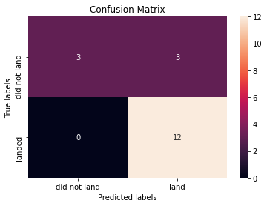



Building a Machine Learning pipeline
Train
Grid search
Preprocessing
Train Test
Split
Confusion Matrix
MODEL
Logistic Regression
Decision Tree Classifier
K-nearest Neighbours
Support Vector Machine
Test

Slide 23
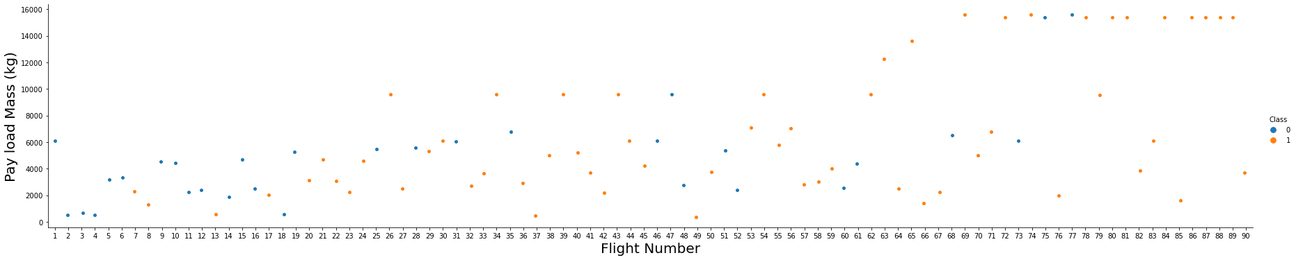
EDA with visualization results
TASK 1: Visualize the relationship between Flight Number and Launch Site

Slide 24
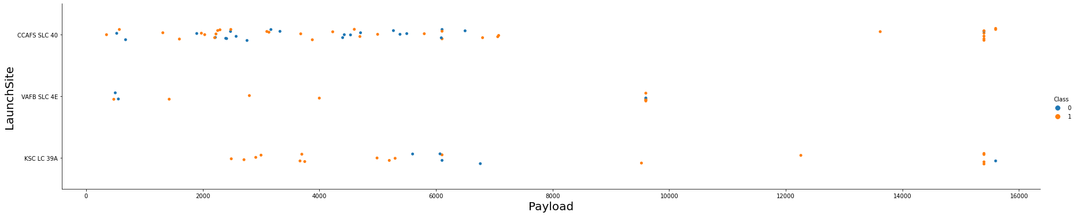
TASK 2: Visualize the relationship between Payload and Launch Site

Slide 25
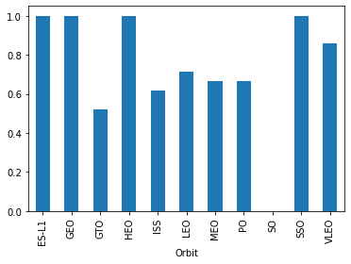
TASK 3: Visualize the relationship between success rate of each orbit type

Slide 26
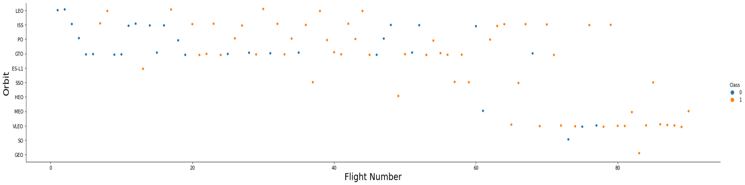
TASK 4: Visualize the relationship between FlightNumber and Orbit type

Slide 27
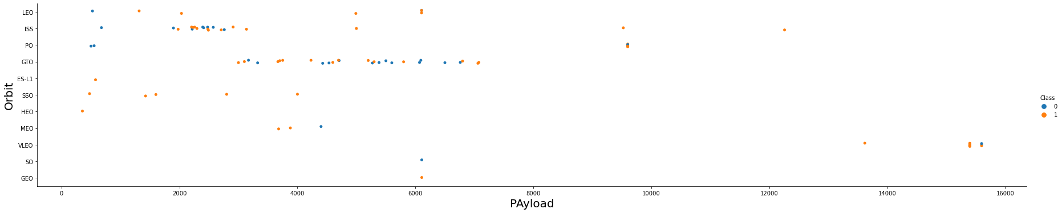
TASK 5: Visualize the relationship between Payload and Orbit type

Slide 28
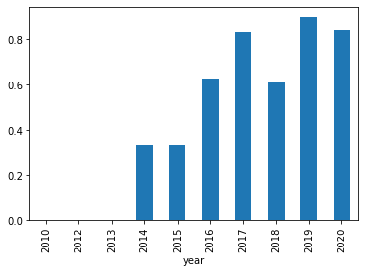
TASK 6: Visualize the launch success yearly trend

Slide 29
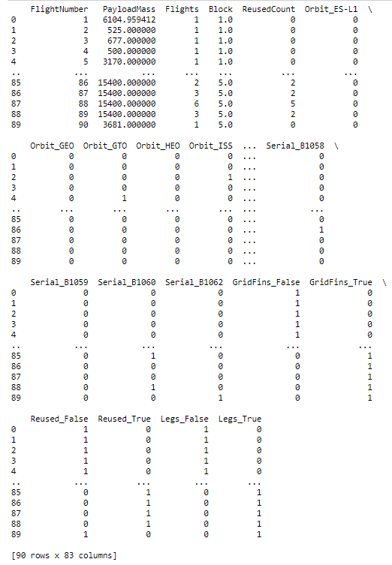
TASK 7: Create dummy variables to categorical columns

Slide 30
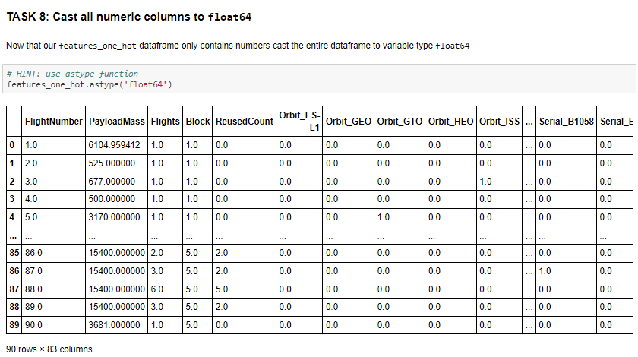

Slide 31
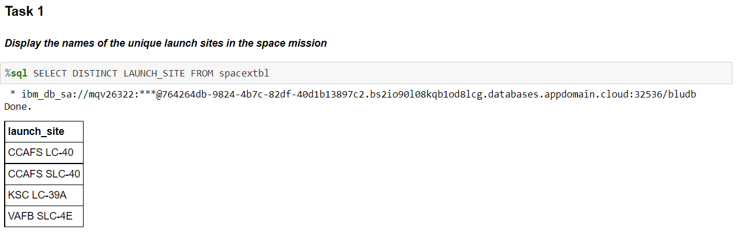
EDA with SQL Results

Slide 32
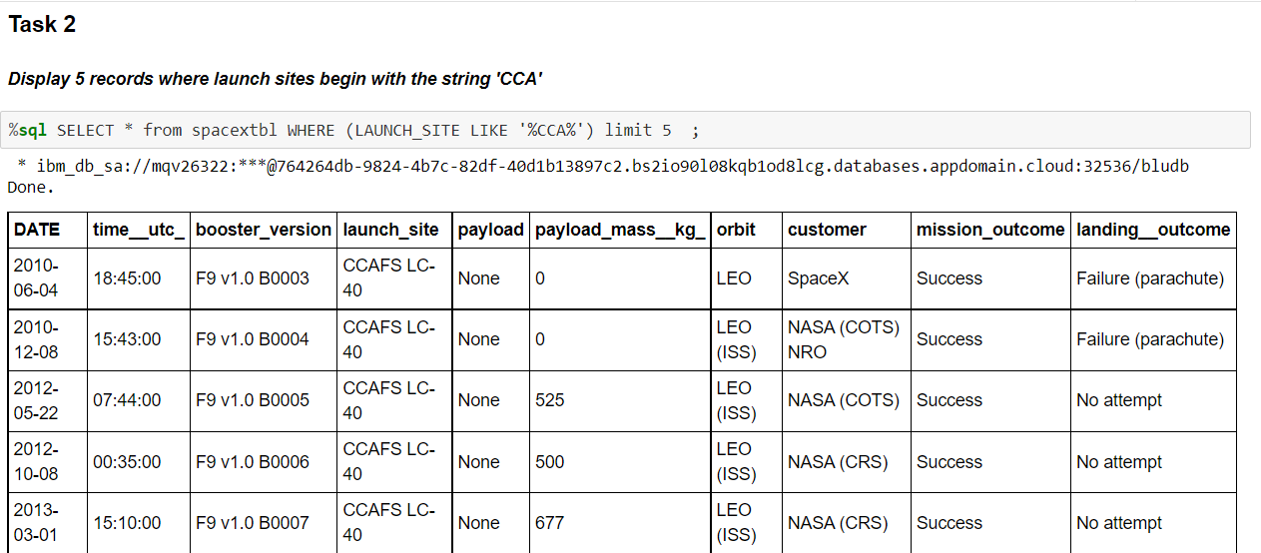

Slide 33
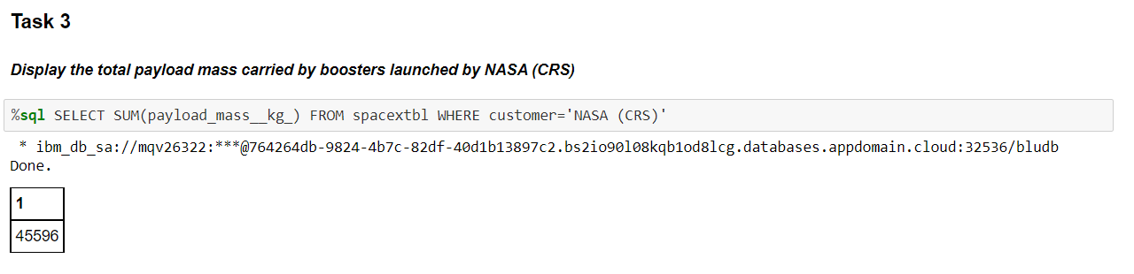

Slide 34
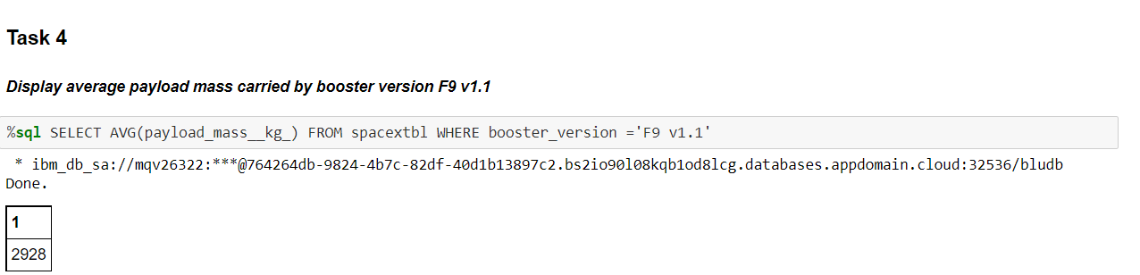

Slide 35
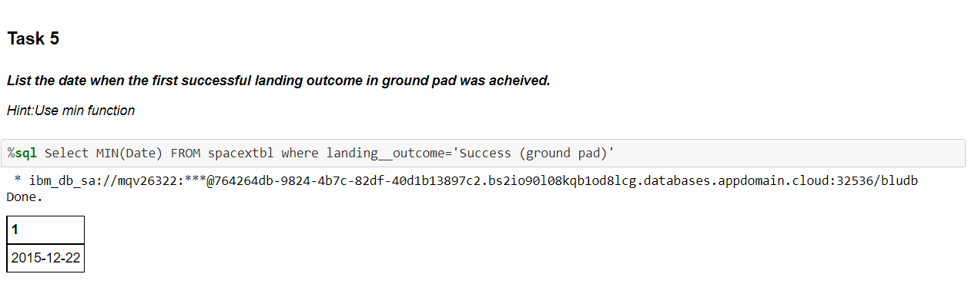

Slide 36
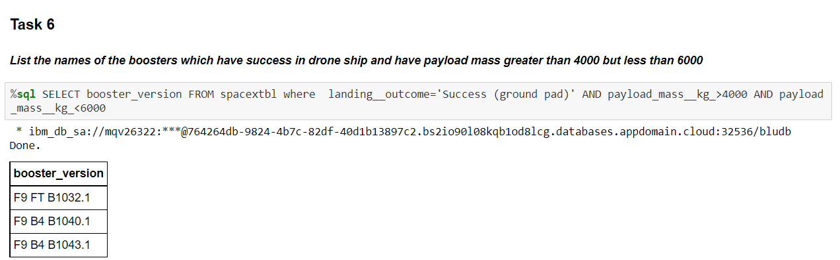

Slide 37
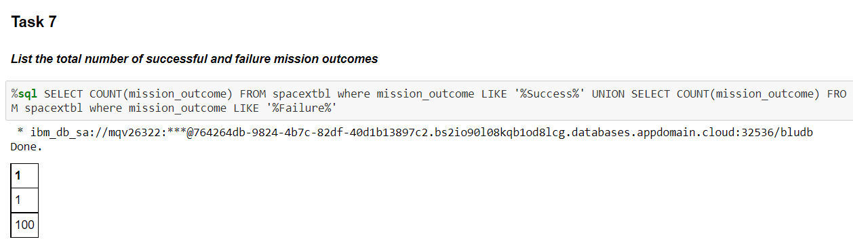

Slide 38
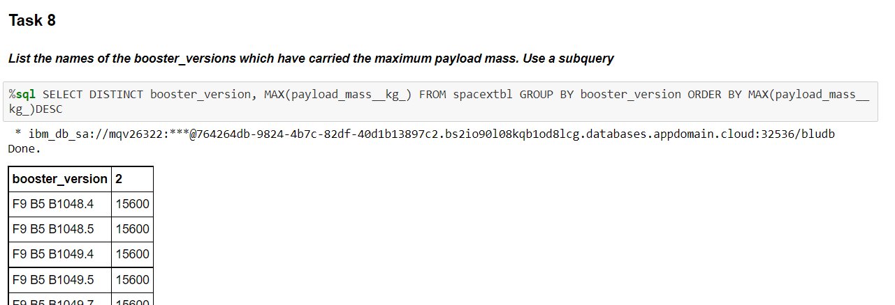

Slide 39
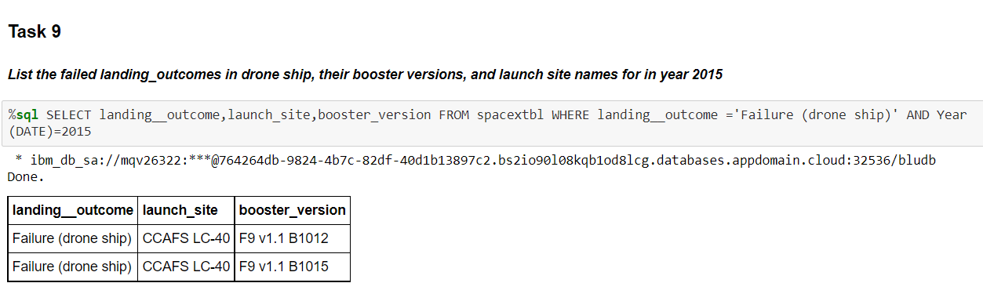

Slide 40
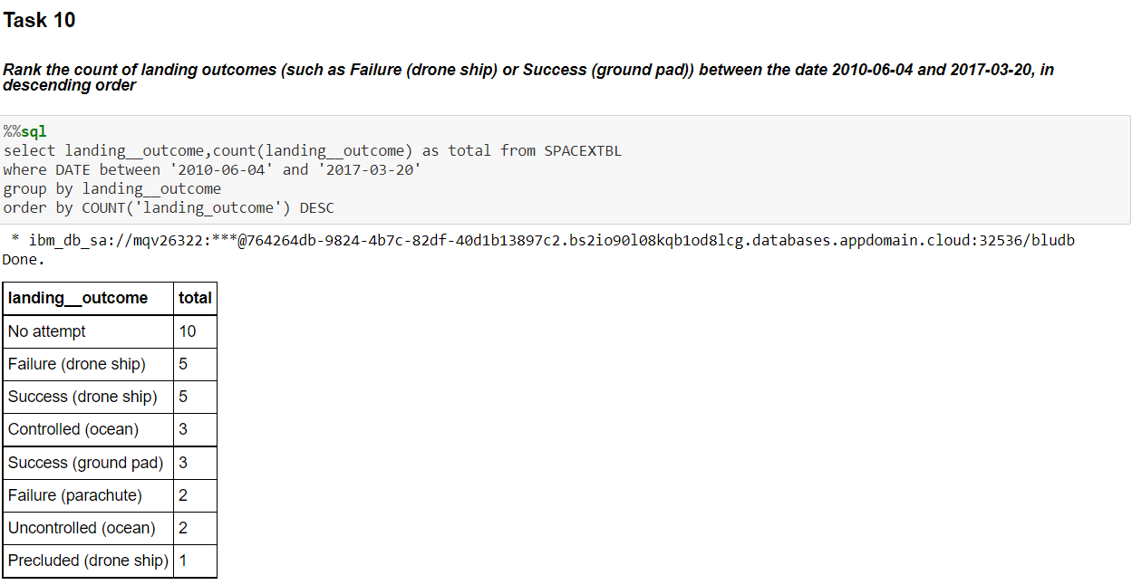

Slide 41
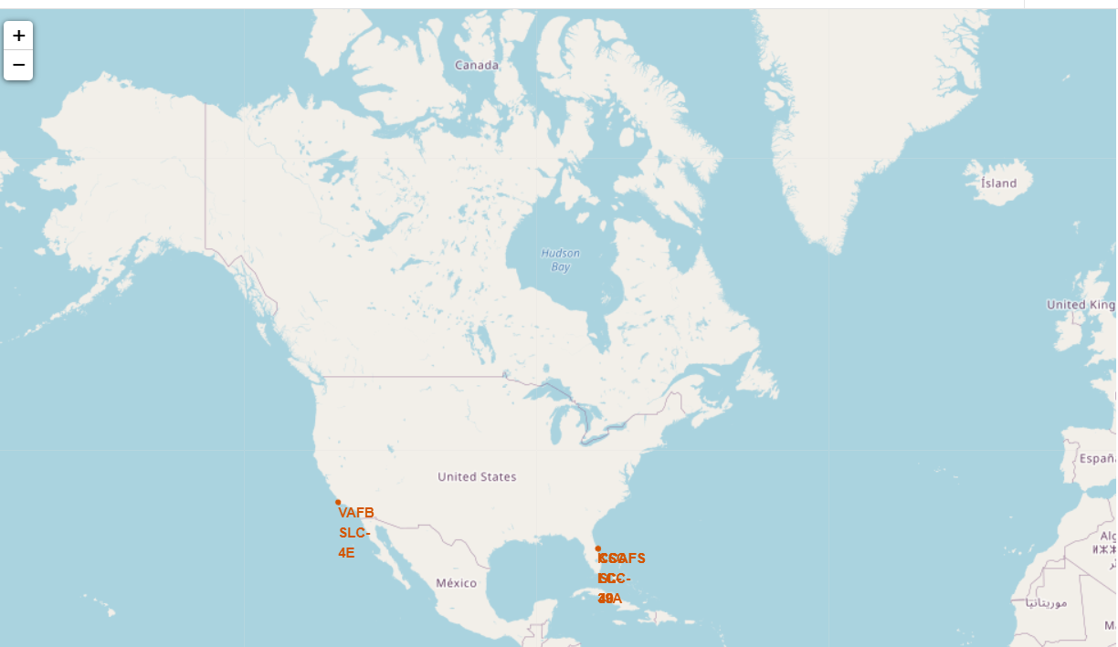
EDA with Folium
Task 1: Mark all launch sites on a map

Slide 42
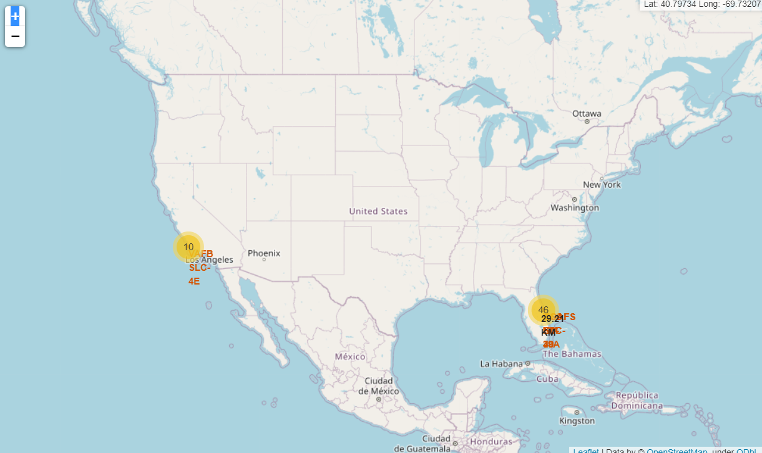
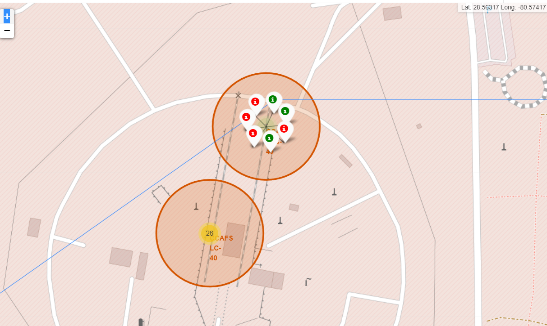
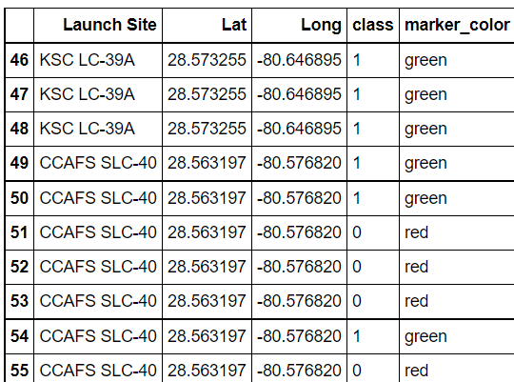
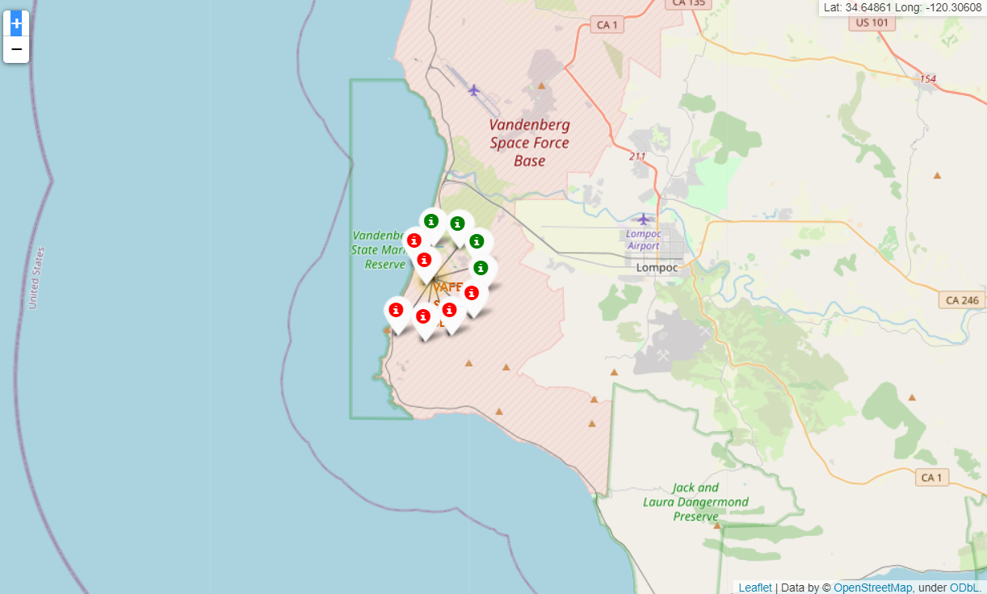
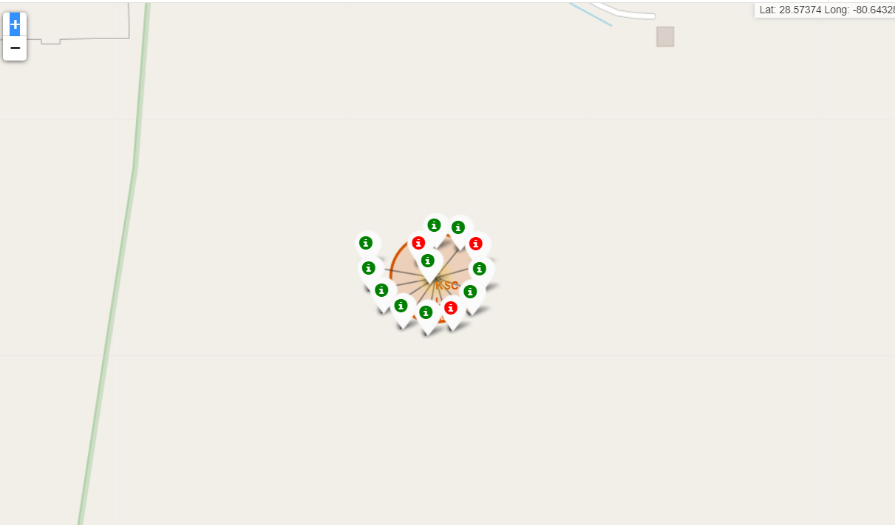
Task 2: Mark the success/failed launches for each site on the map

Slide 43
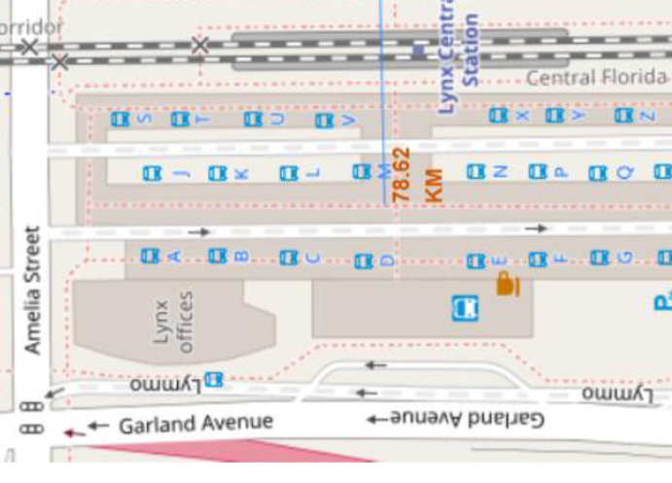
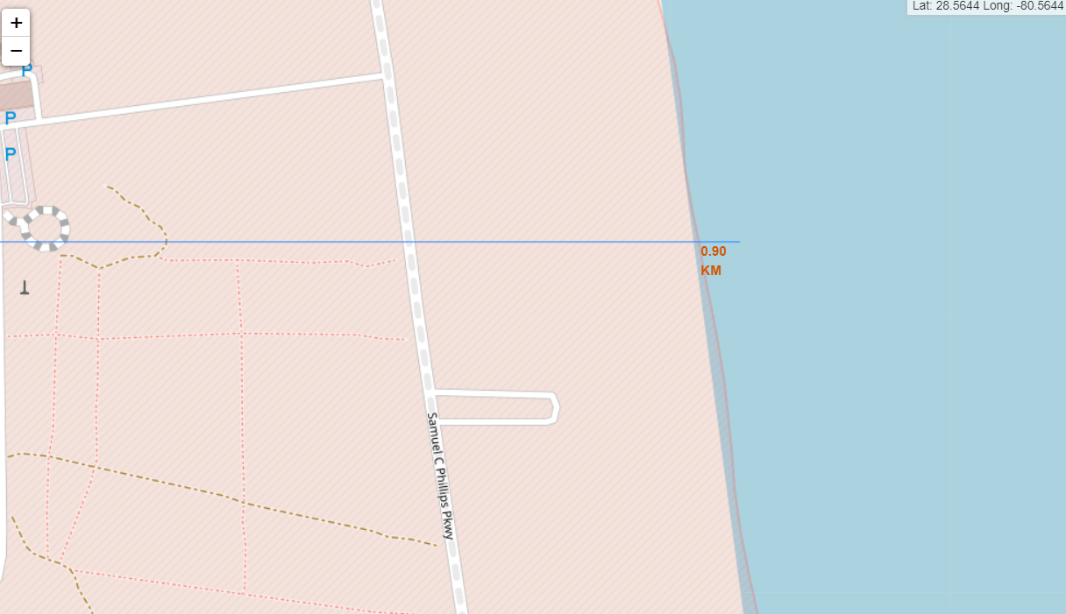
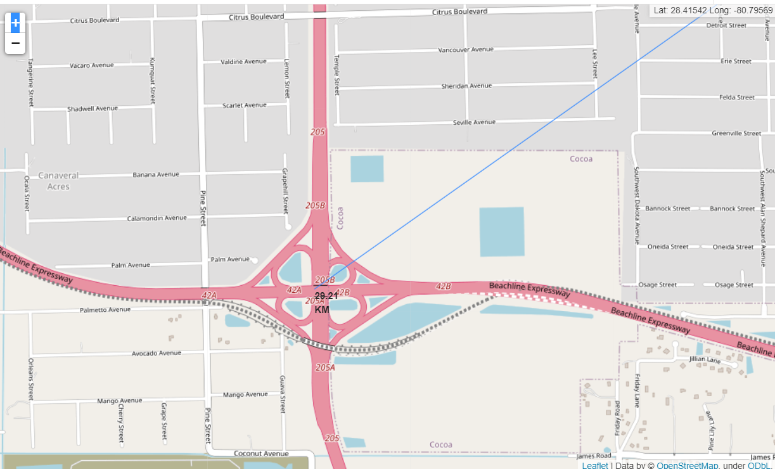
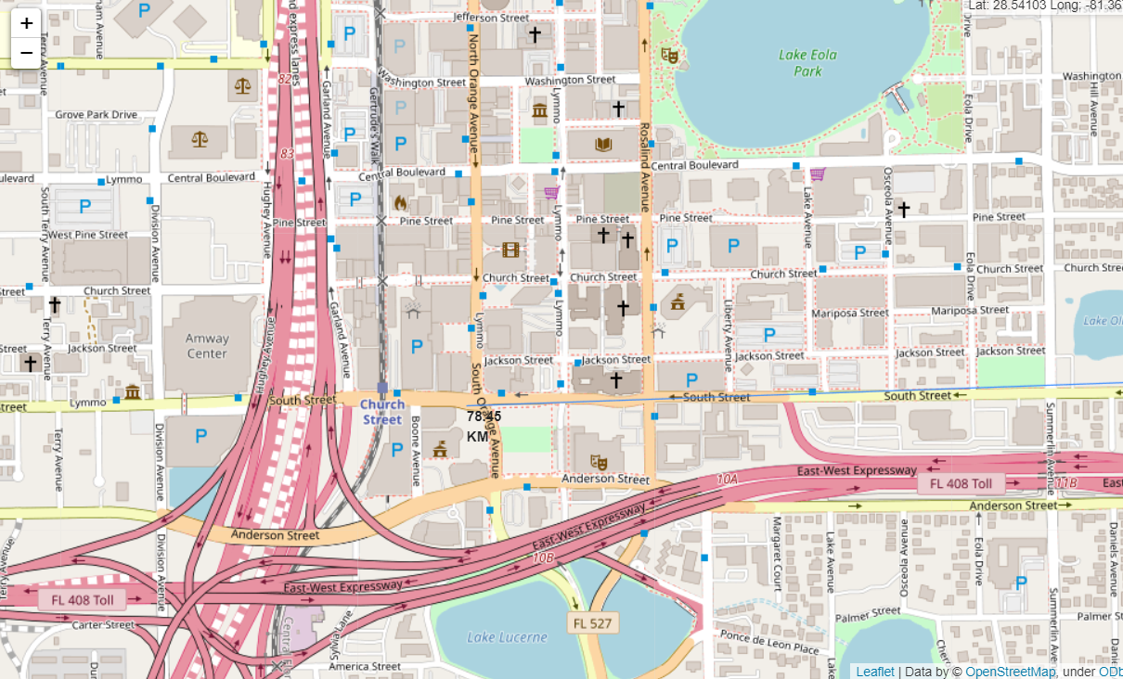
TASK 3: Calculate the distances between a launch site to its proximities
1.Nearest Coastline
2. Nearest Railway
3.Nearest Highway
4.Nearest City

Slide 44
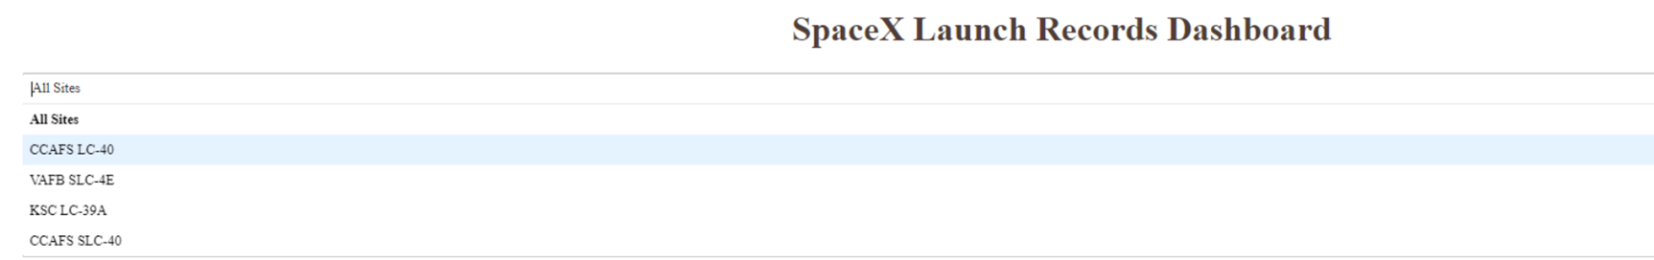
EDA With Dash Results
Add a Launch Site Drop-down Input Component

Slide 45
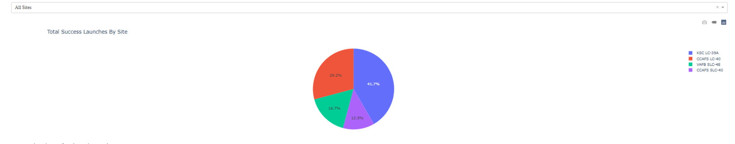
Task 2
Add a callback function to render success-pie-chart based on selected site dropdown

Slide 46
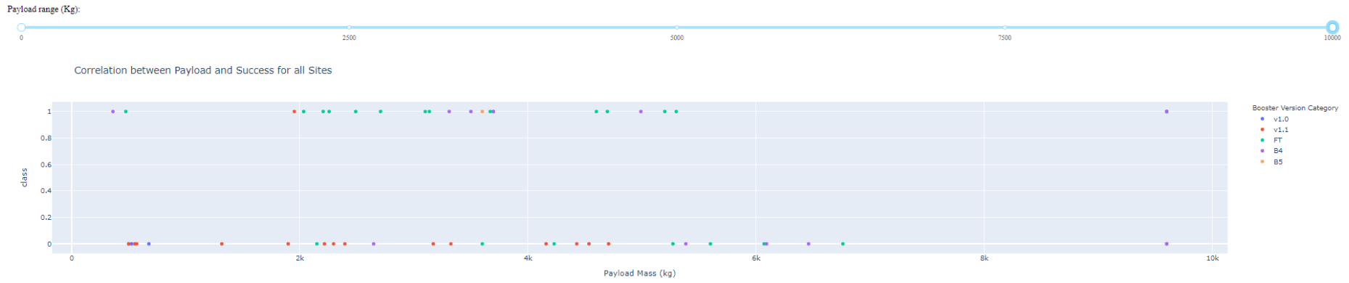
Task 3 and 4
Add a Range Slider to Select Payload
Add a callback function to render the success-payload-scatter-chart scatter plot

Slide 47
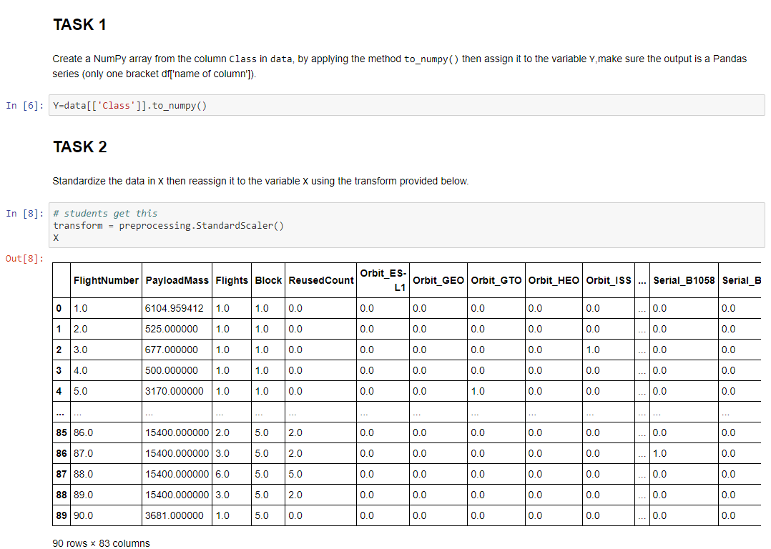
Predictive Analysis Results

Slide 48
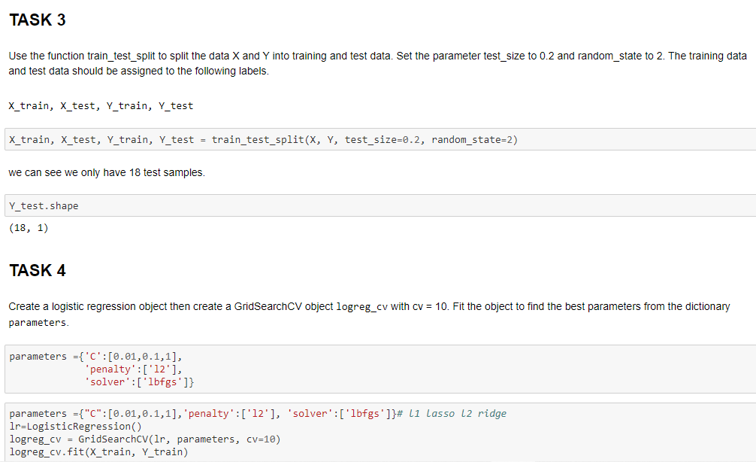
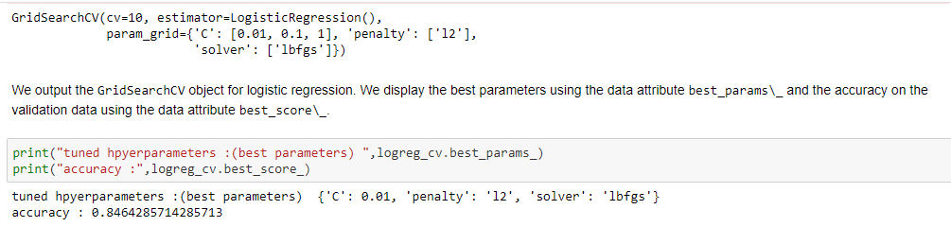

Slide 49
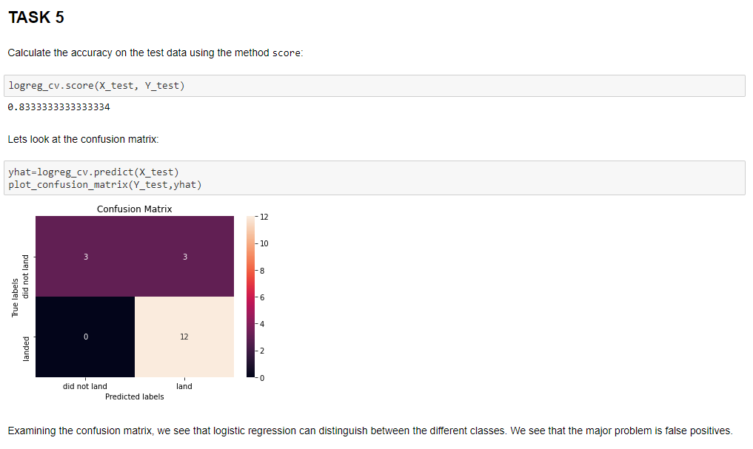

Slide 50
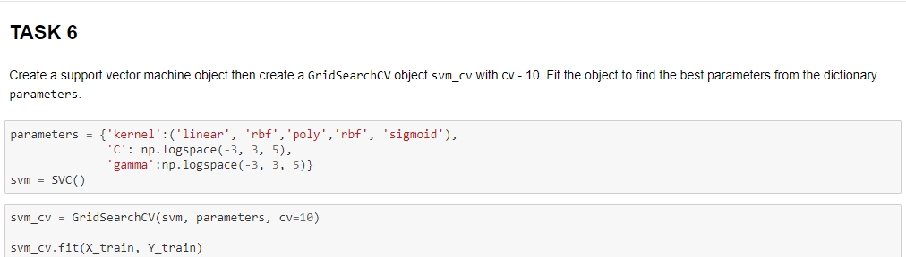
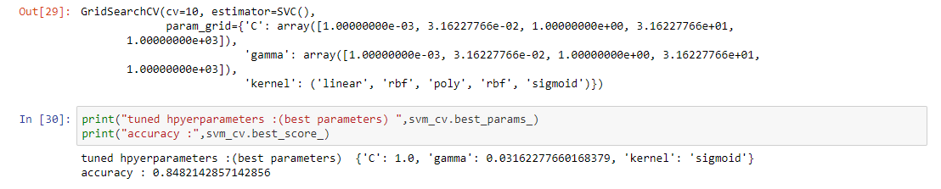

Slide 51


Slide 52


Slide 53


Slide 54



Slide 56


Slide 57
Insights and Conclusion
Launch sites are close to coastlines
Launch sites are a certain distance away from Cities
Launch sites are not close to Railways and Highways
KSC LC-39A had the most successful launches
Success for Low weighted Payloads was higher than High weighted Payloads.
With more time Space X will perfect their Launching as the success rate is directly proportional to time.
GEO,HEO,SSO,ES-L1 had the best success rate.

Slide 58
Github link
https://github.com/bvarsh/IBM-DS-Capstone-project

